Slide 1
Background & Use Case
Our Goal:
Optimize the job application experience! Upload a resume and get job postings that match best
Use Case:
Upload resume in PDF format and parse it for calculating skill match
Needs for Python Library:
PDF-to-text extraction
Notes:
Janice

Slide 2
Python Package Choices
PyMuPDF
Authors: Jorj X. McKie, Artifex Software Inc.
Purpose: High performance Python library for data extraction, analysis, conversion & manipulation of PDF (and other) documents
Both open-source AGPL and commercial license agreements
PyPDF4
Authors: Mathieu Fenniak, Ashish Kulkarni, Steve Witham
Purpose: Pure-python PDF library capable of splitting, merging together, cropping, and transforming pages, adding custom data, viewing options, and passwords, and retrieving text and metadata from PDFs
Open-source BSD license
Notes:
Elaine

Slide 3
Package Comparison
PyMuPDF
Pros:
Extracts text
Maintains original structure
Removes unnecessary spaces
Consistency with different resume formats
Cons:
Issue with words sometimes lumping together
Sometime can't recognize line breaks
Can't extract hyperlinks
PyPDF4
Pros:
Extracts text
Alternative versions exist (PyPDF, PyPDF2,...)
Lighter package
Cons:
Does not maintain the original structure
Performance inconsistency depending on the format of resume
Notes:
Nguyen

Slide 4
Our Choice
PyMuPDF for Resume Data Extraction
Automatic text pre-processing
Removes unnecessary spaces
Consistency with different resume formats
Easy to install and use
Text is extracted quickly
Support multiple kinds of document formats for many functions
Notes:
Kel

Slide 5
Drawbacks/Remaining Concerns
Concerns:
Sometimes lumps words together
Drawback Mitigation:
Use standard fonts: Times, Calibri, Arial, etc.
Implement checks on the output
Format Control
Other Potential Issues:
Missing out important keywords
Eliminating sensitive information like demographic for future bias
Notes:
ly

Slide 6
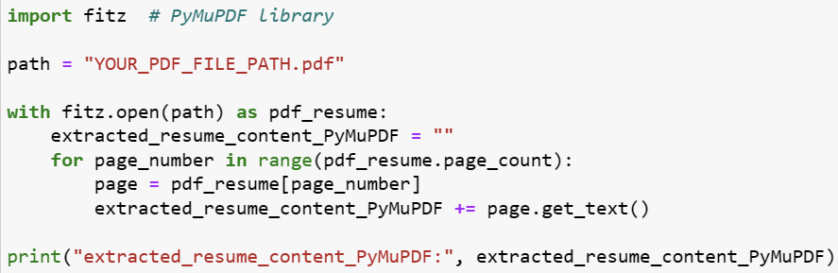
Package Demonstration
Sample Code:

Slide 7
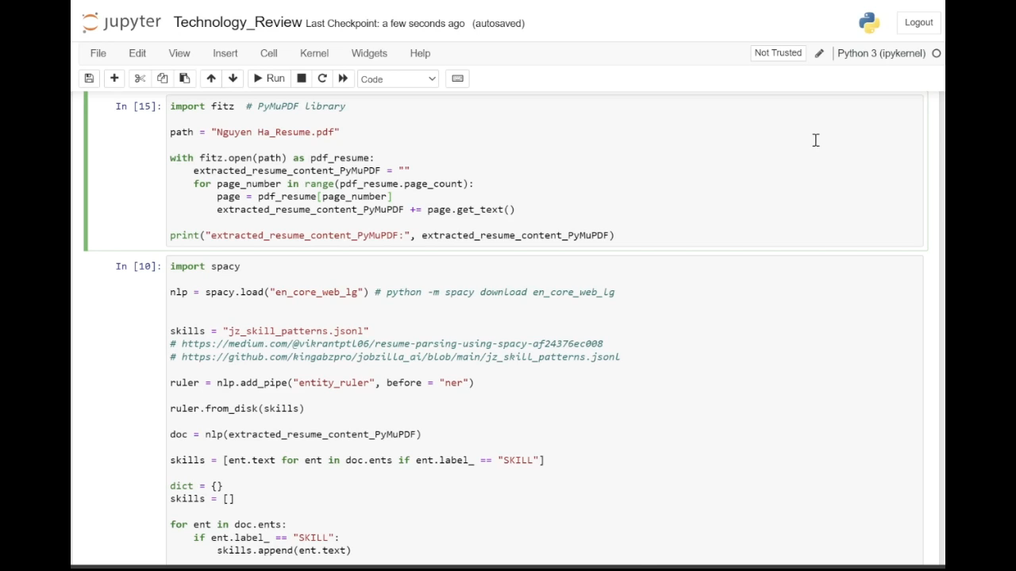
Package Demonstration

